Slide 1
CSE302: Computer Networks Project
TITLE
FTPS CLIENT-SERVER APPLICATION WITH
AES ENCRYPTION USING DIFFIE-HELLMAN KEY EXCHANGE
PRESENTED BY :
NAME : CHITRALA VARUN TEJA
REG NO : 124157012
CSE CYBER SECURITY AND BLOCKCHAIN TECHNOLOGY
Guide Name: Dr. R. Kavitha, CSE/SoC, SASTRA University
Date of Presentation: 14.12.2022
1

Slide 2
Points to be discussed
Aim & Objective.
Problem Statement & Solution.
System Configuration: Platform, Software, Network type, Protocols used.
Proposed Protocol Description.
Need for Security.
Work Flow Diagram.
How the security is given?
Problem & Solution of the requirement of Symmetric key.
How is the connection established b/w client-server?
Work Done (Implementation code link).
Sample I/O (screenshot).
Merits & demerits of this project
References.

Slide 3
AIM & OBJECTIVES
The aim of the project is implementing the FTPS protocol for producing security of files over TCP/IP based Network on Client-Sever environment.
Objective 1: understanding FTPS,SFTP protocols
Objective 2: implementing the protocols using java
Objective 3: Creating windows application using java

Slide 4

Problem Statement & Solution
PROBLEM STATEMENT
Need of data security over network in Client-Server environment.
SOLUTION
Implementing FTPS protocol using java.
Implementing AES ciphering algorithm for encryption of files.
Implementing Diffie-Helman key for exchanging symmetric encryption keys without being spoofed.

Slide 5
System configuration
Client
- Platform: Windows
- Software used :
Java 18.0.1.1 Eclipse 4.12
- Network: Wireless
- Protocol : FTPS
Server
Network: wireless
Protocol : FTPS

Slide 6
Protocol description
Ftp is an application layer protocol published as RFC 114( RFC- request for commands it is a formal document/ memorandum published by IETF which describes methods, behaviors, applicable to the working of the internet ).
FTP uses TCP/IP suite at the Transport layer due to the requirement of reliable data transfer(TCP/IP model is used to provide remote login over the network for interactive file transfer and remote access to a server host’s system)
There are set of FTP commands which are universal with the help of which the client can communicate with the server. The server responds using corresponding server reply codes.
Why do we need to think about FTP Software Applications?
It is difficult to remember all the commands and reply codes which leads to the introduction of FTP client-server software. This software uses GUI to send commands to the FTP server by using some buttons without typing each command.

Slide 7
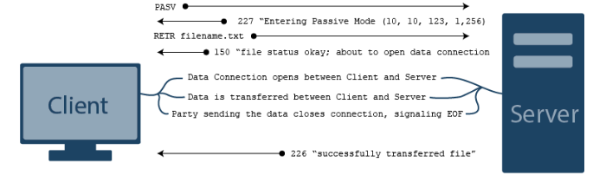
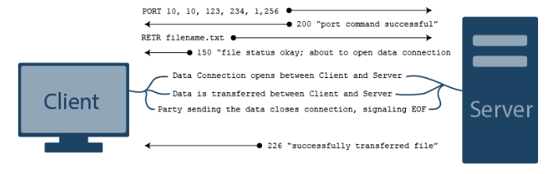
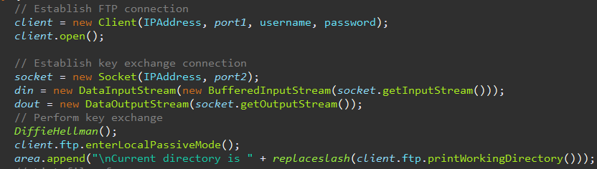
WORKING : ( FTP modes)
Passive Mode—
The client issues a PASV command to indicate that it will wait “passively” for the server to supply an IP and port number, after which the client will create a Data Connection to the server.
Active Mode—
The client issues a PORT command to the server signalling that it will “actively” provide an IP and port number to open the Data Connection back to the client.
Why passive mode?
Passive FTP is easier to get through firewalls. For "active" FTP, the client has to be connectable from the internet, for passive ftp, that burden is on the server.

Slide 8
Types of ftp
FTP types
There are several different ways an FTP server and client software can conduct a file transfer using FTP:
Anonymous FTP. This is the most basic form of FTP. It provides support for data transfers without encrypting data or using a username and password. It's most commonly used for download of material that is allowed for unrestricted distribution.
Password-protected FTP. This is also a basic FTP service, but it requires the use of a username and password, though the service might not be encrypted or secure. It works on port 21.
Secure FTP (SFTP): This is technically not an FTP protocol, but it functions similarly. Rather, SFTP is a subset of the Secure Shell (SSH) protocol that runs over port 22. SSH is commonly used by systems administrators to remotely and securely access systems and SFTP provides a mechanism within SSH for secure file transfer.
FTP over SSL/TLS (FTPS). This approach enables explicit TLS support by upgrading an FTP connection over port 21 to an encrypted connection. This is a commonly used approach by web and file sharing services to enable secure file transfers.

Slide 9
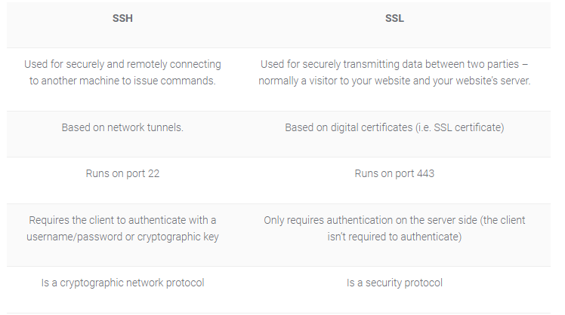

Slide 10
Need for Security
Initially, FTP was not designed to be secure. The main goal of FTP is to share files located in a network server among multiple clients.
The only security to files was the authentication of users(built-in authentication method that requires users to provide a valid Windows user name and password to gain access to content), whatever,This can be easily forged which when makes data insecure.
So, for transferring files that contain some crucial information we need some form of security.

Slide 11
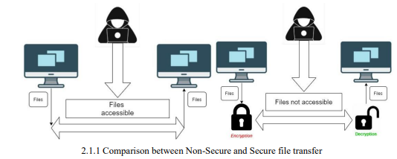
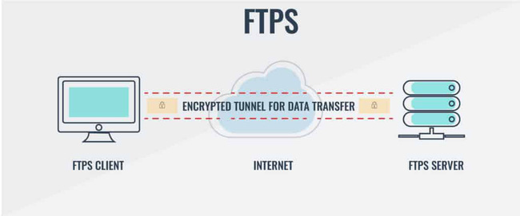
Network Architecture: Client - Server
Work Flow Diagram

Slide 12
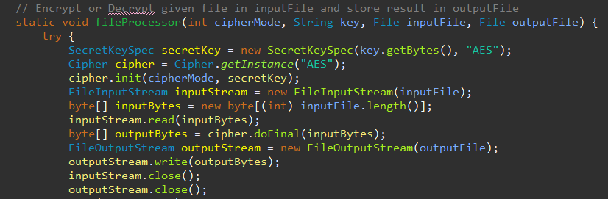
How SECURITY is given?
There are many ciphering algorithms like AES, DES, SHA, and RSA which produce security.
AES is the improvement of DES. It has a fixed block size of 128,192,256 bits. This project uses 128 bits of block size.
AES is a symmetric key algorithm (both client and server should have the same key).
AES is used for many real-time applications in messaging apps like Whatsapp, signal…etc.
Many programming languages like C++, java, and python supports AES by using simple function calls in the library.
In this project security is given using the AES Cyphering algorithm and written in java using a cryptography library.

Slide 13
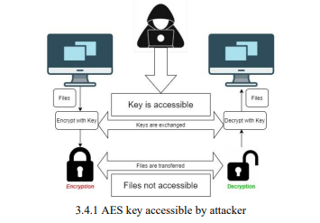
PROBLEM DUE TO REQUIREMENT OF SYMMETRIC KEY.

Slide 14
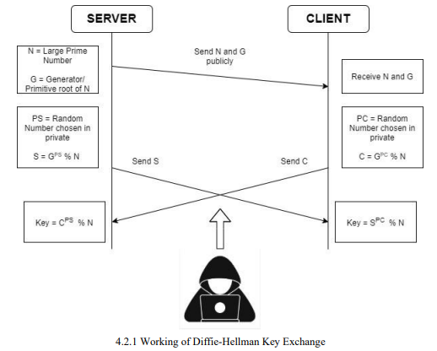
FLOWCHART : Working of Key Exchange
SOLUTION: DIFFIEE HELLMAN KEY EXCHANGE
Here the attacker only knows the S, G,N,C but not the algorithm used to find the key.

Slide 15
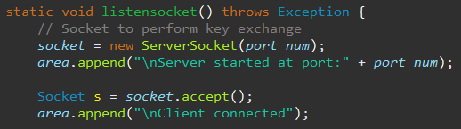
How is the connection established b/w client-server
Sockets allow communication of two processes that are running on the same or different machines.
Sockets are mostly used in client-server architecture for communication between multiple applications.
Socket programming tells us how we can use socket API for creating communication between local and remote processes.
socket API is a collection of socket calls that enable you to perform communication functions between application programs like Setting up and establishing connections to other users on the network., Send and receive data to and from other users.
The socket is created by the combination of the IP address and port number of the software. With this combination, the process knows the system address and the address of the application where data is to be sent.
Socket in server side:
Socket in client side:

Slide 16
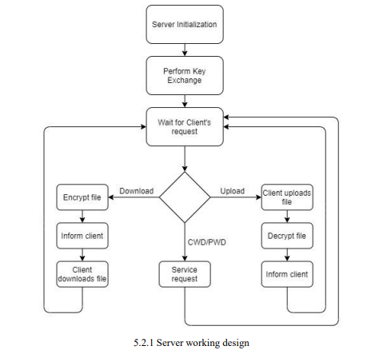
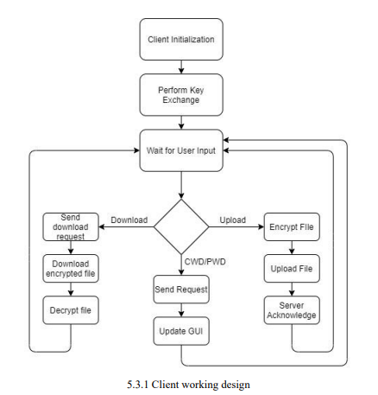
FLOWCHART : IMPLEMENTING ENCRYPTION IN CLIENT SIDE AND SERVER SIDE

Slide 17
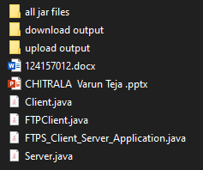
Work done so far
Jar files for headers
Output Folder for downloaded files
Output folder for uploaded files
File to be transferred
Project PPT
Code of FTPS
Link for implemented code:
https://drive.google.com/drive/folders/12U5tF3mw9lne-yGFb8ZM745FOUg_OWPE?usp=share_link

Slide 18
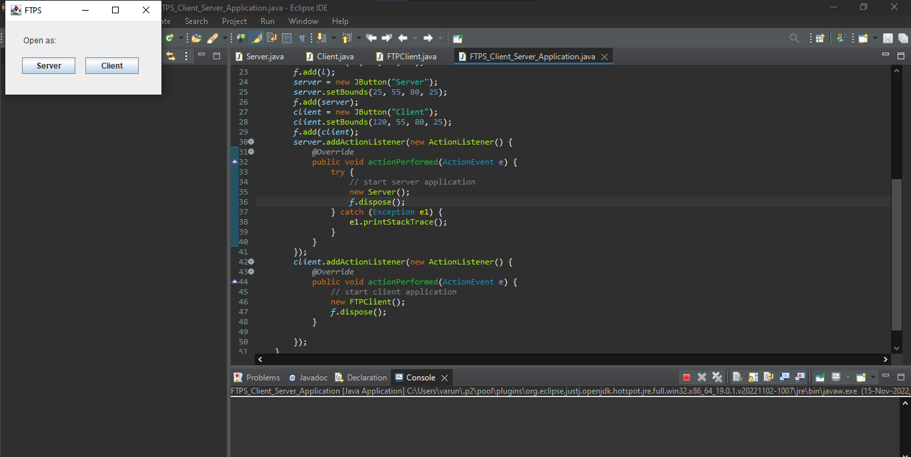

Slide 19
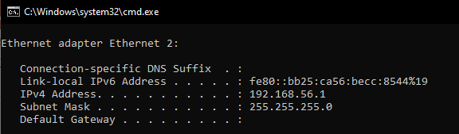
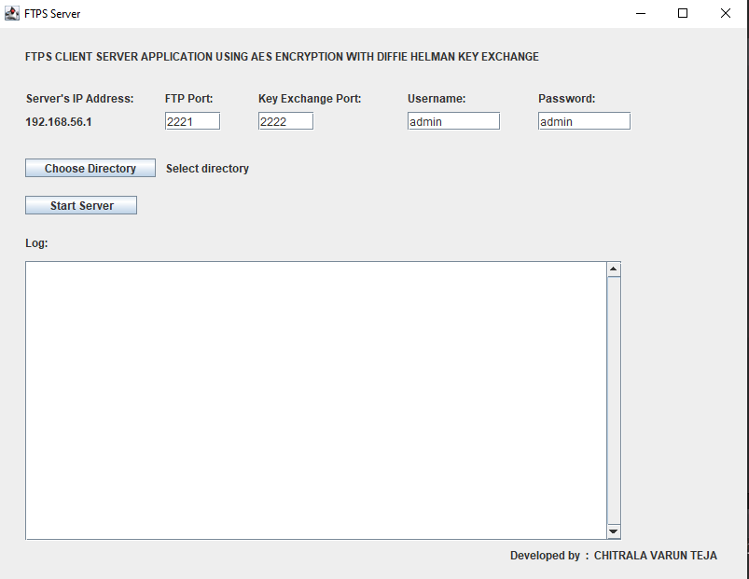
1st choose a folder
And then START SERVER

Slide 21
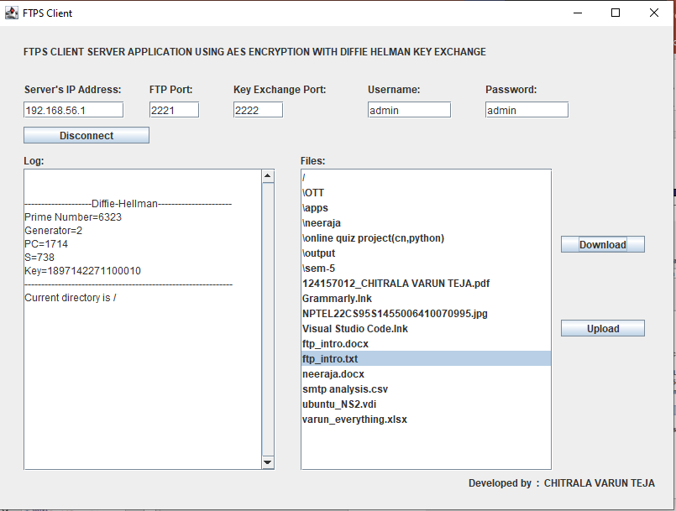

Give SERVER IP address
And then CONNECT to the server

Slide 22
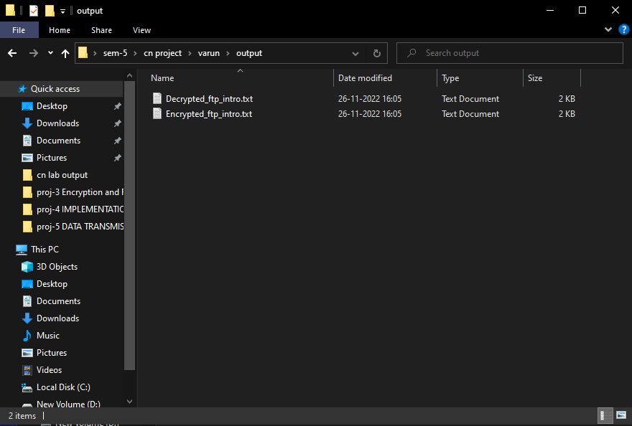
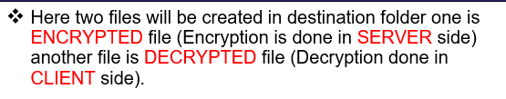
Sample I/O screen shots
DOWNLOAD a file from SERVER

Slide 23
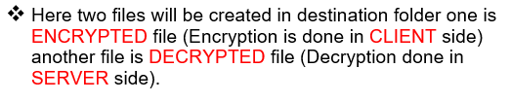
Similarly we can UPLOAD a file to SERVER from CLIENT.
UPLOAD a file to SERVER.

Slide 24
Merits & demerits of this project
MERITS
The following benefits are associated with this project:
A safe method of transferring files over an insecure public channel.
Strong encryption is provided by using the AES algorithm.
Because the Diffie-Hellman Key Exchange generates new symmetric keys for each session, there is no need to manage encryption keys.
The underlying FTP running on TCP ensures reliable data transfer.
DEMERITS
Some of the drawbacks of this implementation include:
The client's hardware should have enough processing power to encrypt and decrypt large files. On low-end hardware, files larger than 100 MB take a noticeable amount of time to encrypt or decrypt.
When dealing with multiple clients, the server must also deal with the processing power required to encrypt and decrypt large files.
The client's requests and the server's responses are not encrypted

Slide 25
References
15
James F. Kurose, Keith W. Ross “Computer networking A top-down approach” 7th edition.
Apache FTP Server Documentation - FtpServer Documentation — Apache MINA
Apache Commons Net FTP Client - FTPClient (Commons Net 1.4.1 API) (apache.org)
AES - Advanced Encryption Standard – Wikipedia.
AES Key Schedule - AES key schedule – Wikipedia.
Diffie Hellman Key Exchange”- cryptography - "Diffie-Hellman Key Exchange" in plain English - Information Security Stack Exchange

Slide 26
17
Thank You

